Slide 1
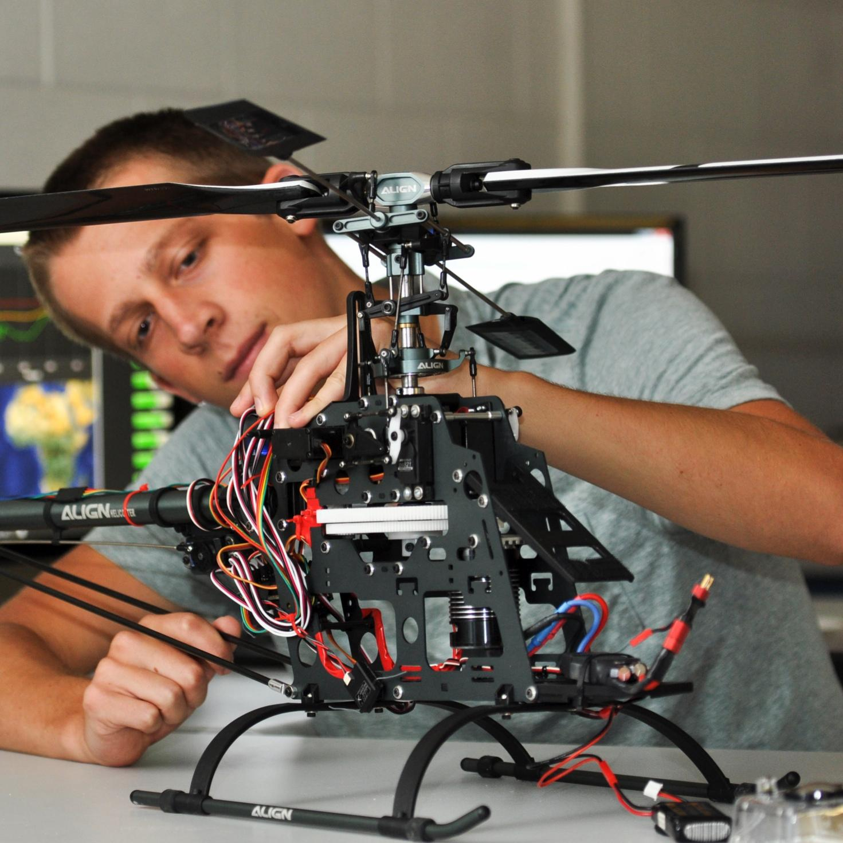

Team 27: Personalized Financial Advisor App for Students
Bi-Weekly Update 4
Camille Embree, Hoang-Nghi Nguyen
TA: Sabyasachi Gupta

Slide 2

Project Summary
Financial management is difficult for many students, with irregular income, high living expenses and a general lack of tools and the incentive to provide clear visibility on personal spending.
Our app addresses this by using AI and machine learning to work with transaction tracking through categorization and personalized financial feedback.

Slide 3
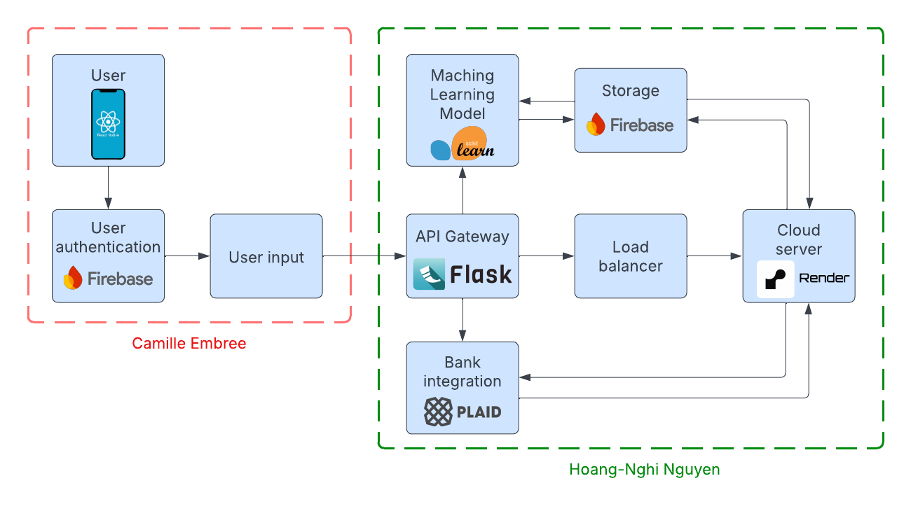
Project/Subsystem Overview

Slide 4
Project Timeline
Database and Plaid API testing (completed 9/18) | Polished application pages (completed 10/14) | Plaid API integration (completed 9/25) | Final Integration (to complete by 10/27) | System Test (to complete by 11/2) | Validation (to complete by 11/26) | Demo and Report (to complete by 12/5)

Slide 5
Subsystem 1
Camille Embree
Accomplishments since last update 26 hrs of effort | Ongoing progress/problems and plans until the next presentation
Finalized two mini game UIs Updated screen layouts Integrated Firebase between front-end and back-end | Transfer data collection from Firebase to backend API Connect frontend operations to Plaid Finalize last two mini game UIs

Slide 6
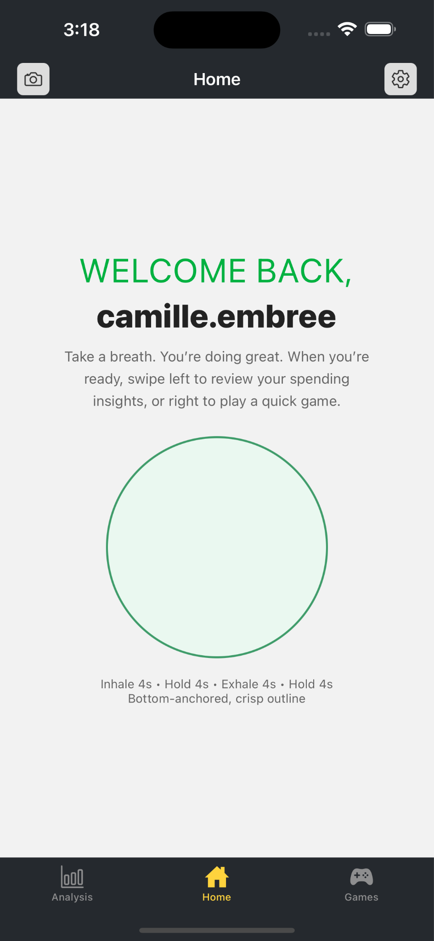
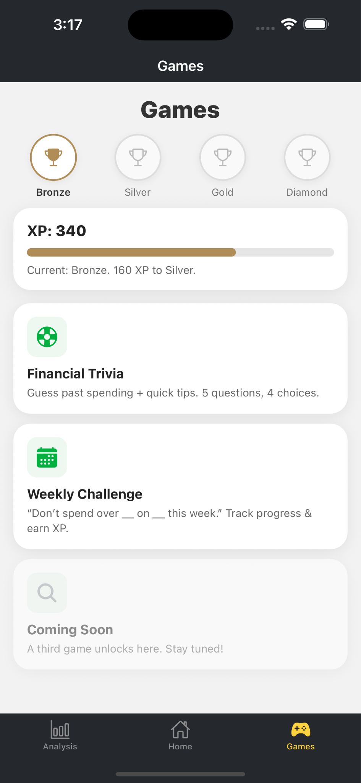
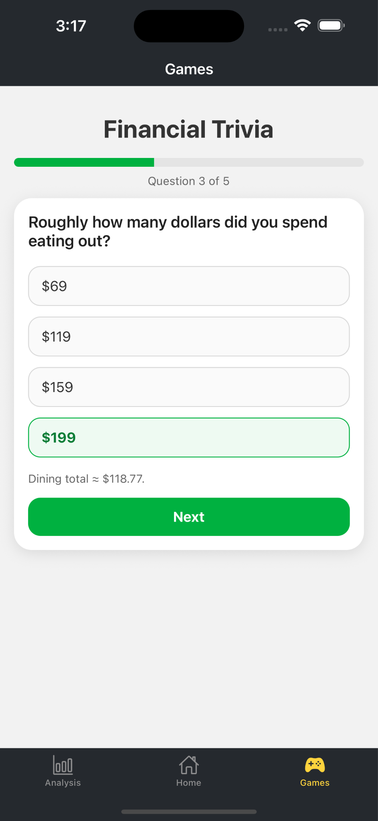
UI Design

Slide 7
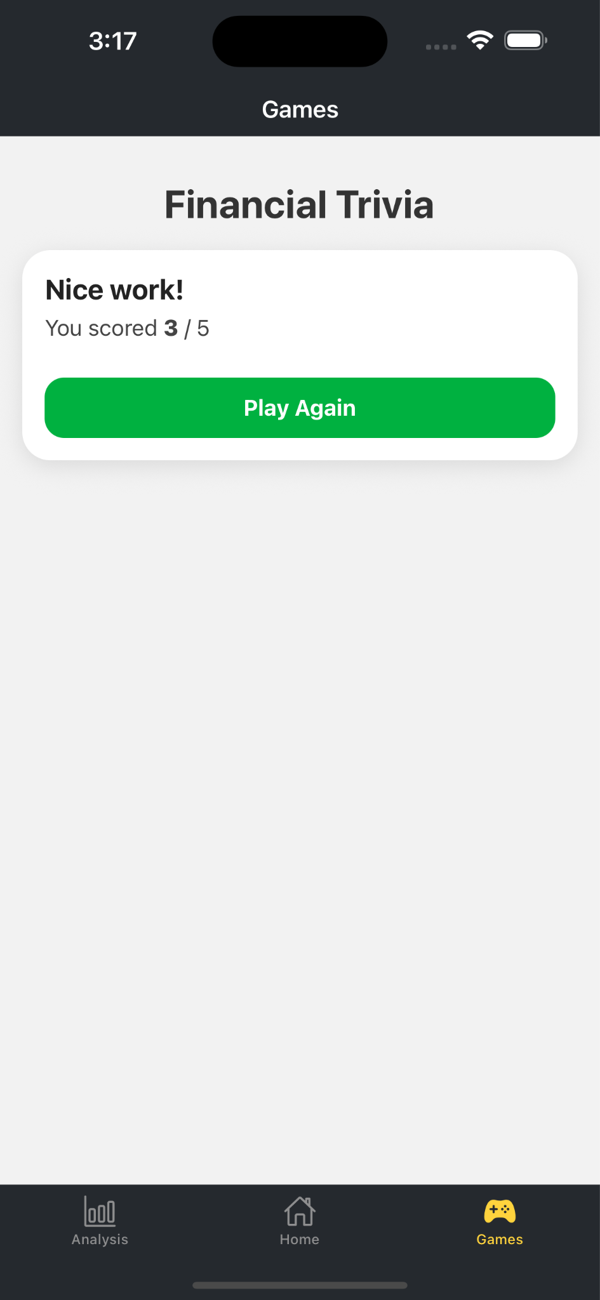
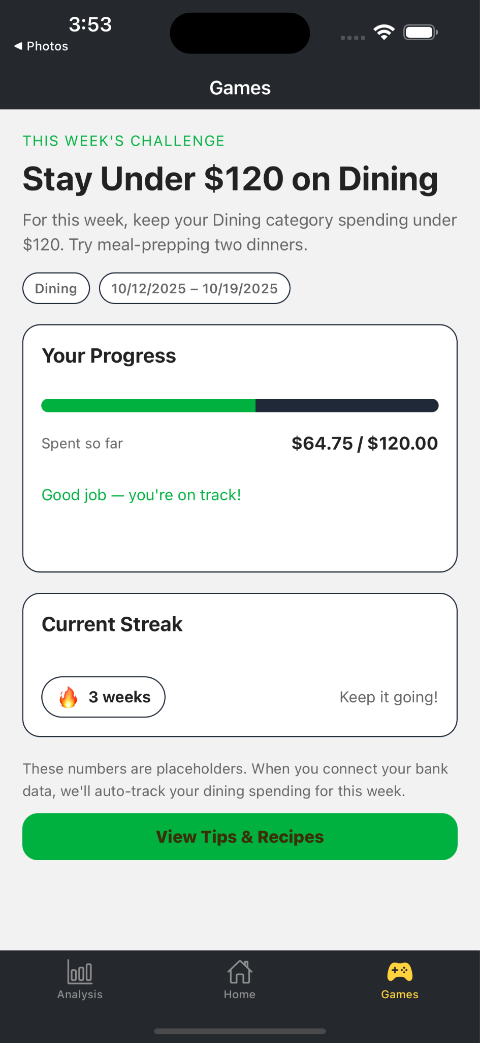
UI Design

Slide 8
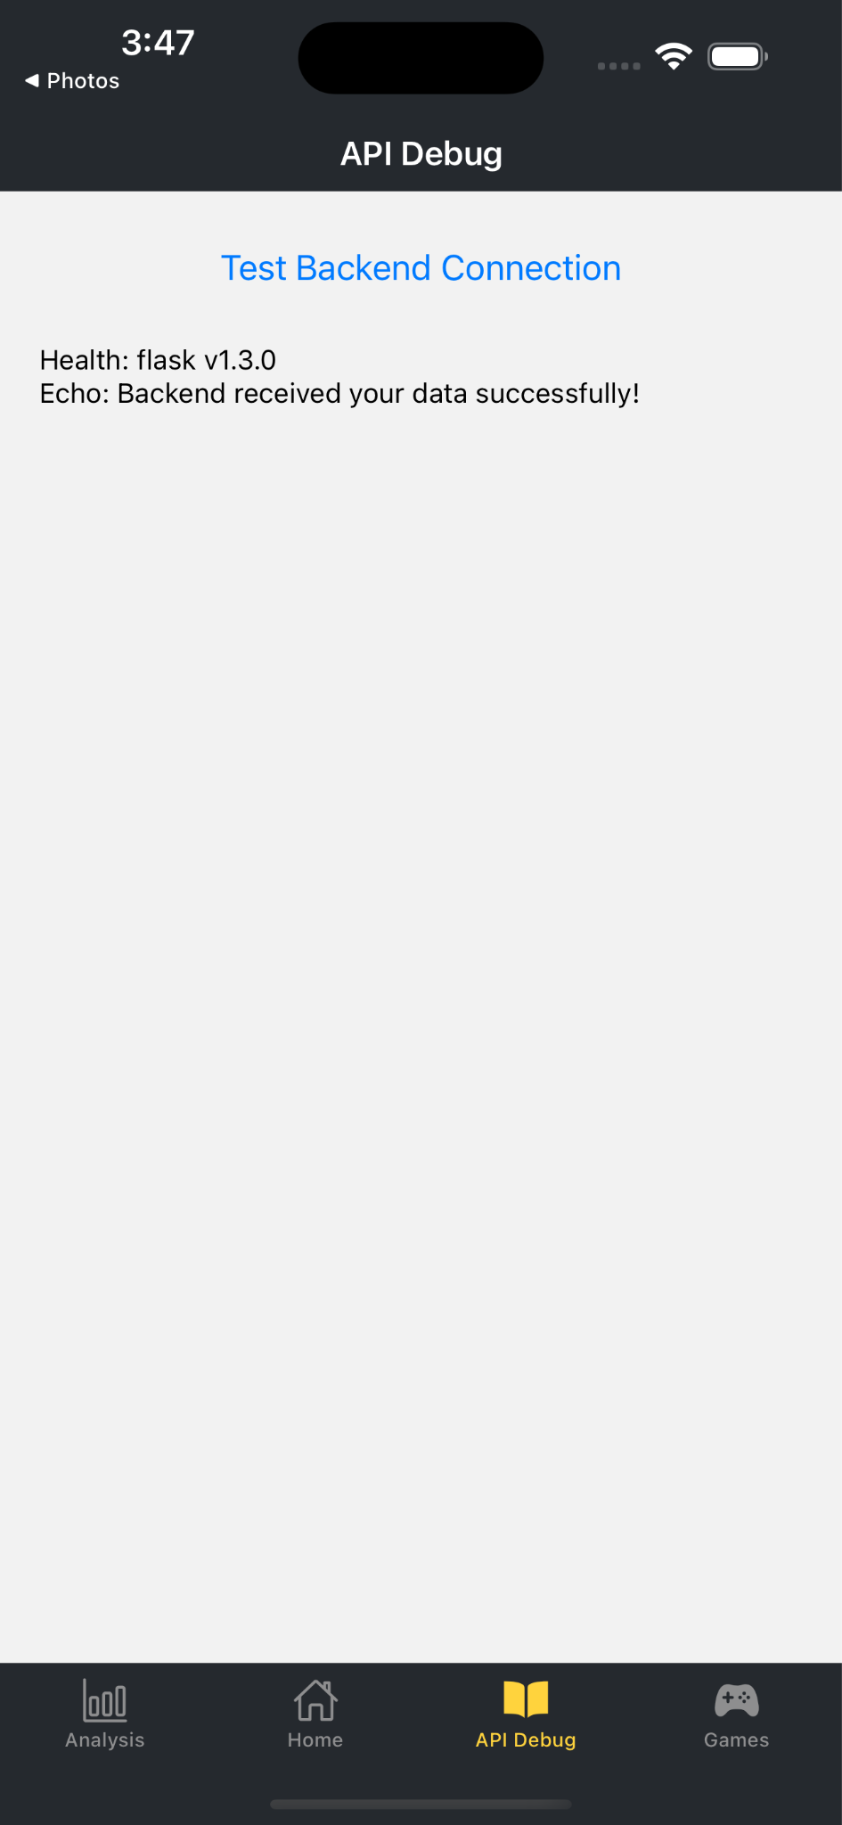
API Connection Test

Slide 9
Subsystem 2
Hoang-Nghi Nguyen
Accomplishments since last update 41 hrs of effort | Ongoing progress/problems and plans until the next presentation
MInigame backend structure complete with ML forecasting (Budget Streak Challenge, Smart Saver Quiz, Spend Detective, Financial Categories) Implemented modular API routing, Firebase Admin SDK, public/private documents per user in Firebase. Deployed Backend on Google Cloud (accessible from anywhere, permanent public URL, no longer needs to be run locally) | Test API endpoints for minigame functionality on frontend Integrate protected endpoints from backend requests to frontend for app functions using Plaid Link and authentication Rate limiting to prevent spamming of endpoint calls

Slide 10
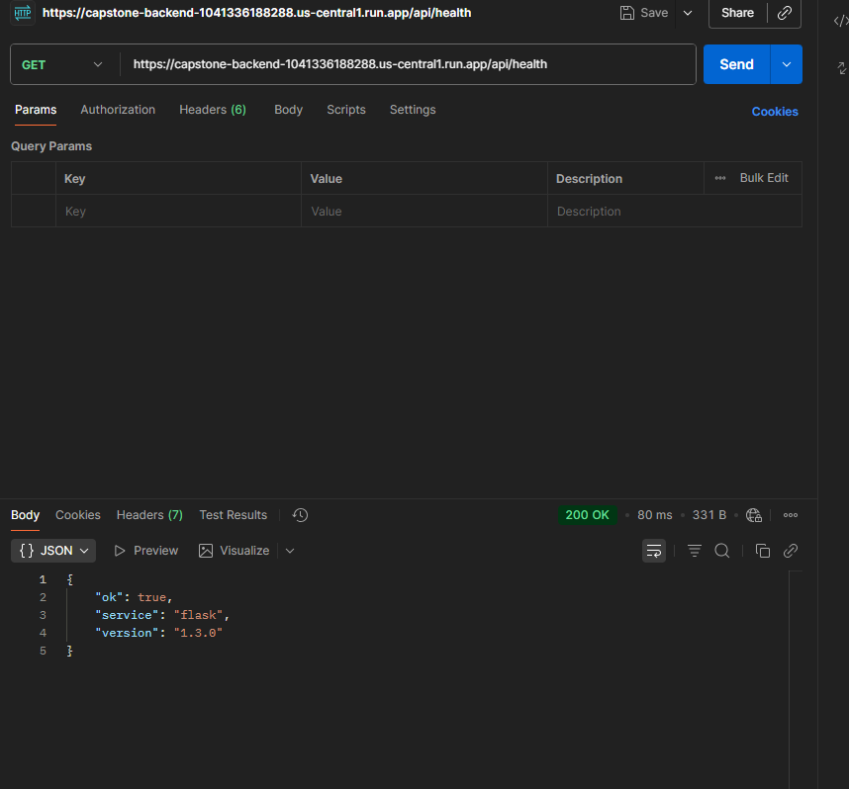
Subsystem 2

Slide 11
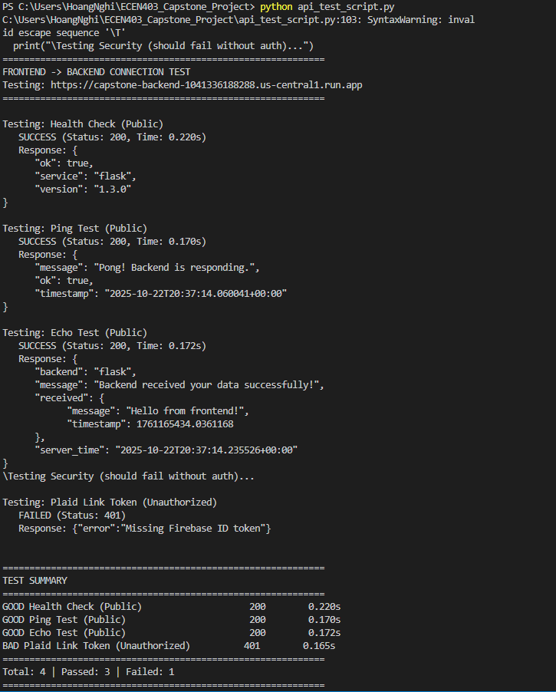

Slide 12
Execution Plan
 | 8/31/25 | 9/7/25 | 9/14/25 | 9/21/25 | 9/28/25 | 9/31/25 | 10/5/25 | 10/12/25 | 10/19/25 | 10/26/25 | 11/2/25 | 11/9/25 | 11/16/25
Solidify Database Organization
Plaid API Sandbox Testing |  |  |  |  |  |  |  |  |  |  |  | Not started
Make UI More Relaxing |  |  |  |  |  |  |  |  |  |  |  | In Progress
Implement Breathing Animation |  |  |  |  |  |  |  |  |  |  |  | Completed
Plaid API Integration |  |  |  |  |  |  |  |  |  |  |  | Behind Schedule
Integrate Joint Database
Frontend-Backend API Connection
ML Forecaster Design
Backend Financial Minigame Design
Forecaster Game UI Design
Financial Trivia UI Design
Budget Streak UI Design
Financial Connections UI Design
Frontend Plaid User Setup

Slide 13
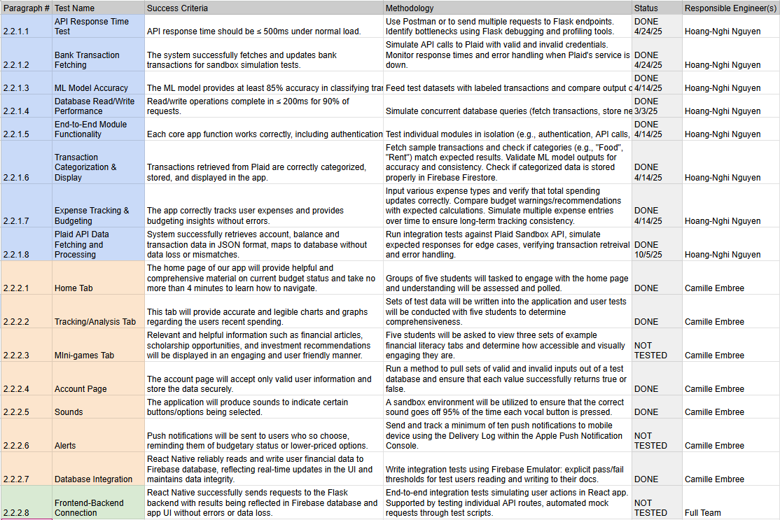
Validation Plan

Slide 14
Thank you

